Slide 1
Extended essay Guide: May 2023
Mr. Matthew Q. Larson
larsononline1@gmail.com

Slide 2
Please save subject specific questions until the end of the meeting
I will ask for questions periodically so please hold questions until then.

Slide 4
What is the extended essay (ee)?
In-depth study of a focused topic
chosen from DP subjects
Normally one of six chosen IB subjects
NOT Required
Intended to promote academic research and writing skills
Opportunity to engage in personal research in a topic of your own choice
Guided by a supervisor
All work MUST be done via Google Docs

Slide 5
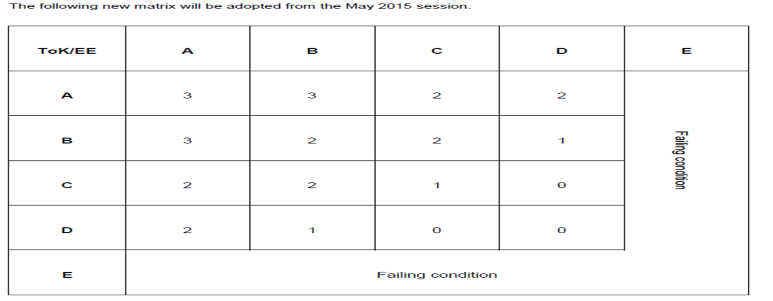
Compulsory for all Full DP Students
Optional for course students
Must earn a D grade or higher to be awarded the full Diploma
EE is externally assessed
Combines with TOK for total of 3 points
EE process helps prepare students for success at university

Slide 6
Presented as a formal piece of sustained academic writing containing
Maximum of 4,000 words plus 500 word reflection form
40 hours of work by the student
Plan accordingly
Supported by a supervision process (Minimum 5 hours)
Includes three mandatory reflection sessions.
Viva Voce
Concluding interview with the supervising teacher

Slide 7
The Aim of the EE
The aims of the extended essay is for student to:
Pursue independent research on a focused topic
Develop research and communication skills
Develop the skills of creative and critical thinking
Engage in a systematic process of research appropriate to the subject
Experience the excitement of intellectual discovery.

Slide 8
Assessment Objectives
Plan and pursue a research project with intellectual initiative and insight
Formulate a precise research question
Gather and interpret material from sources appropriate to the research question
Structure a reasoned argument in response to the research question on the basis of the material gathered
Understand multiple Approaches to Learning (ATL)

Slide 9
Assessment Objectives
Present their extended essay in a format appropriate to the subject, acknowledging sources in one of the established academic ways
( MLA, APA, Chicago, etc.)
Use the terminology and language appropriate to the subject with skill and understanding
Apply analytical and evaluative skills appropriate to the subject, with an understanding of the implications and the context of their research

Slide 10
What to do Next
Listen to the introductory talk on EE (already Done)
Read subject guide over the topics you are interested in
Pick TWO
Look at specific topics in these areas
Develop a research question for each subject
Find three academic sources for each research question

Slide 11
What to do Next
Complete EE Signup
Linked on website
Opens October 24th
Closes November 1st, 12:00 PM
Supervisor assigned
December 2nd
Sign EE Commitment Letter

Slide 12
The Role of the Supervisor
Three mandatory reflection sessions with each student
RPPF form after each meeting
Provide students with advice and guidance in their research
Encourage and support students throughout the research and writing
Help to formulate a RQ
Must ensure that the question satisfies appropriate legal and ethical standards with regard to health and safety, confidentiality, human rights, animal welfare and environmental issues

Slide 13
The Role of the Supervisor
Be familiar with the extended essay and the assessment criteria
Monitor student progress, offer guidance, and ensure that the essay is the student’s own work
Ensure that deadlines are met
Conduct viva voce
Read the final version and, in conjunction with the viva voce, confirm its authenticity
Embrace ATL with students

Slide 14
Reading Student work
Must read and provide feedback on one draft
Supervisors may only read one draft of the EE
Teachers cannot edit the draft
Should take place after the interim reflection session, but before the final reflection session

Slide 15
Teacher skillset

Slide 16
To Be shown to Students
LOOK AT TIMELINE ON WEBSITE
ACADEMIC INTEGRITY
BRIEF OVERVIEW OF RESEARCH PROCESS ON WEBSITE
SOURCE SECTION ON WEBSITE
EE SIGN OUT FORM

